Slide 1
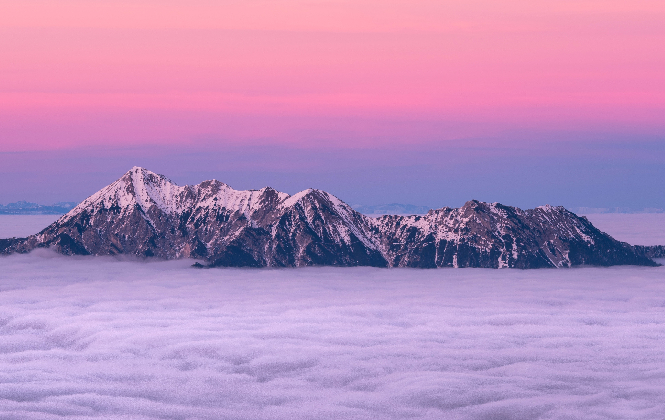
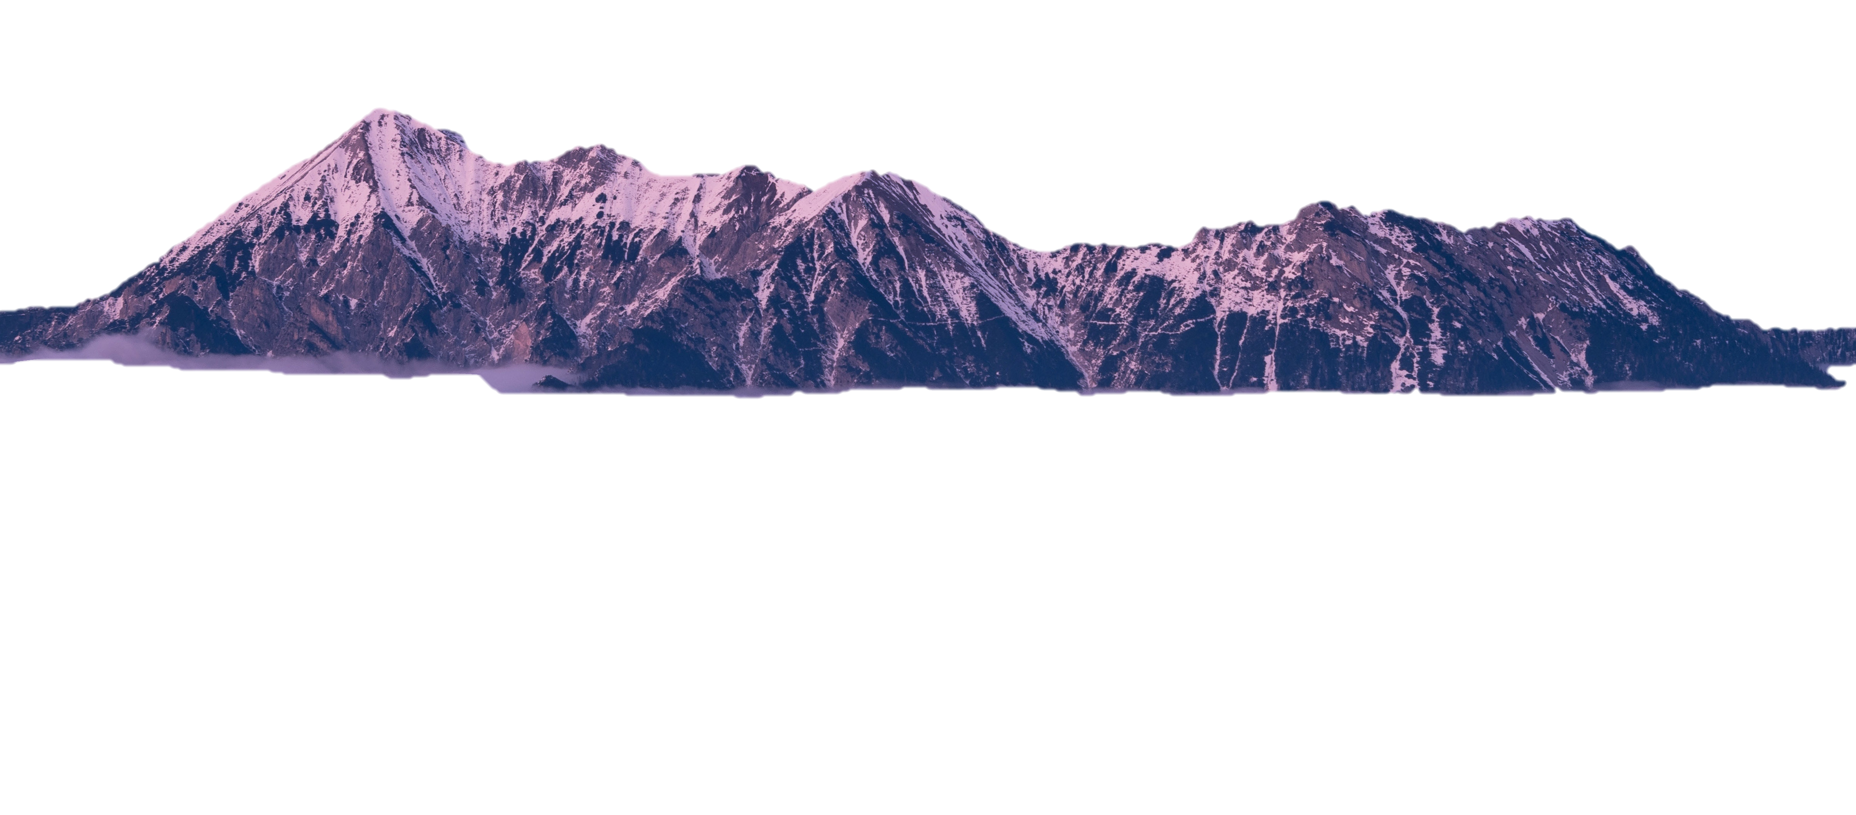
1856
1869
Life and Landscape
2014
2019
NATURE PHOTOGRAPHY
Marsh Leaves
1895
Jackson worked with Union Pacific
Ori Gersht’s On Reflection
Richard Learoyd’s Large Poppies

Slide 2
1856
Life and Landscape
1869
Marsh Leaves
2014
Ori Gersht’s On Reflection
2019
1895
Richard Learoyd’s Large Poppies
Jackson worked with Union Pacific
NATURE PHOTOGRAPHY

